Slide 1
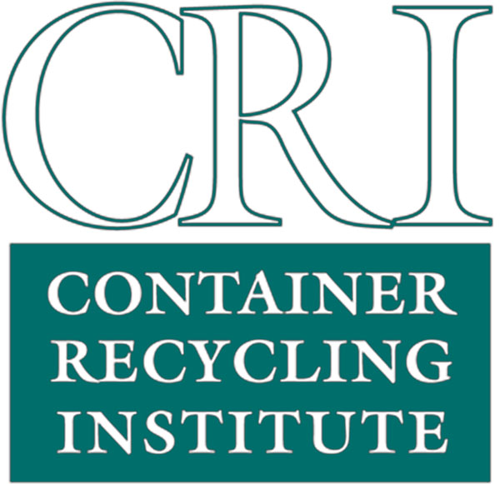
Update on California Bottle Bill Legislation in 2022
Susan V. Collins
Zero Waste Sonoma
November 17, 2022

Slide 2
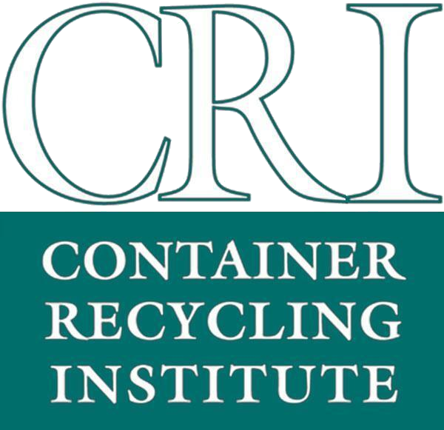
Overview of Changes to California’s Beverage Container Deposit Law
2022 Legislation: Multiple Bills
1) April Budget bill: recycled content stabilization and handling fee stabilization
2) SB 38, anti-fraud and study of contamination
3) SB 54, EPR for Packaging
4) SB 1013, Wine and Spirits +++, $900 million, August
5) AB 179, Budget Bill, $400 million, August

Slide 3
Timeline:
How We Got Here
1) Long, steady decline of program, with losses of 1,200+ redemption centers, and declining redemption rate (2013-present)
2) Inaccurate, underestimated reporting of fund balance by CalRecycle
3) Oversight hearing, April 2022
4) Bills introduced and debated over 2-year session
5) SB 54, EPR for Packaging, June 2022
6) Final week changes to bills added huge spending, in excess of fund balance

Slide 4
California DRS Expansion: Wine and Spirits
Bill | Key Points | Introduction Date
CA SB 1013 | Expand law to include wine and spirits, plus wine coolers and spirits coolers >7% alcohol by volume New containers: Wine and spirits in bag-in-box, pouches, aseptics or similar containers 25¢ refund/deposit on new containers Includes nips! | January 1, 2024
CRI work products, comments, & activities:
See website for 5-page bill summary and 14-page financial analysis, plus letters of testimony.

Slide 5



Benefits of a Wine & Spirits Expansion in California
Higher recycling rates: 59% recycling rate for glass beverage containers:
  500 million more containers recycled;
  300,000 new tons recycled
Produce clean recycled materials for manufacturing
Will support more recycling jobs in California
Would cut beverage container litter for those beverage categories in half
Reduce 160,00 tons of greenhouse gas emissions, the equivalent to taking 23,000 cars off the road
Container Recycling Institute © 2022

Slide 6
Expansion Bill:
Enlargement of Convenience Zones
Bill | Key Points | Introduction Date
CA SB 1013 | CZ radius increased from 0.5 mile to 1 mile Rural areas: CZ radius increased from 3 miles to 5 miles of a supermarket IF new CZ will be served by existing recycling center Existing handling fee sites will retain eligibility to receive handling fees, and will not be penalized for CZ size changes No more “Option B;” Retailers within a CZ can no longer pay $100/day in lieu of accepting container returns; instead, they have an option of joining a dealer cooperative (starts January 1, 2025) | January 2024
CRI work products, comments & activities:
CRI has consistently opposed enlarging the zone sizes, as this has been proposed each year for more than 5 years. There was no opportunity to oppose this erosion of consumer convenience, as this was a last-minute amendment.
Note: CZ maps will need to be redrawn by CalRecycle.

Slide 7
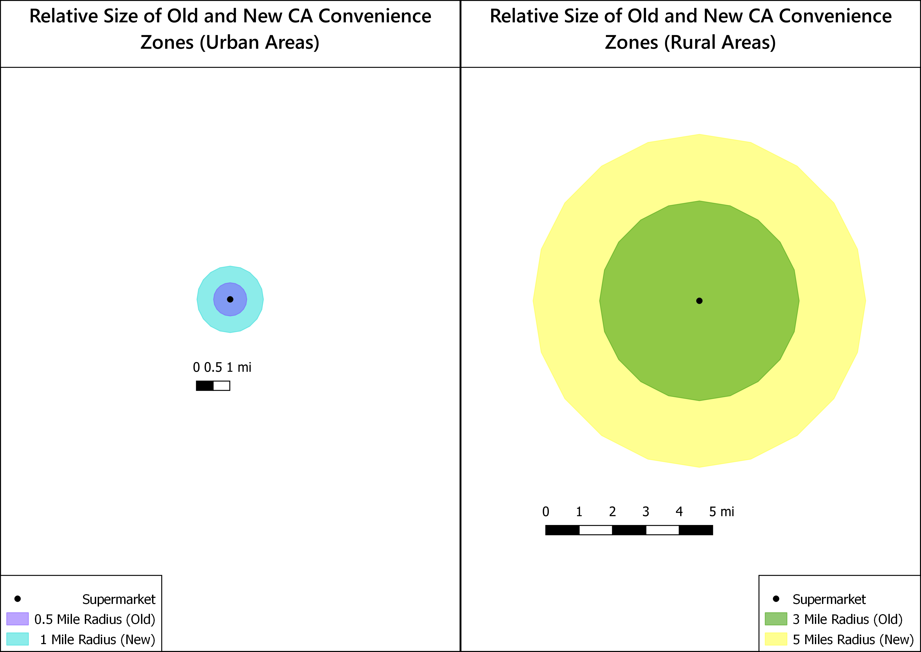

Slide 8
Expansion Bill: Dealer Cooperatives
Bill | Key Points | Introduction Date
CA SB 1013 | Dealers must pay into cooperative If a CZ has no recycling location, or its 60-day hold period has expired, and until a recycling location is established, they must choose one of two options: Take containers in store or in designated site location, and deliver to a recycling location (ineligible for program payments) Join a dealer cooperative and organize to provide redemption in one or more CZs (eligible for program payments unless a certified recycling center is in CZ) | January 1, 2025
CRI work products, comments & activities:
There has been no opportunity to discuss this brand-new concept.

Slide 9
Expansion Bill: Dealer Cooperatives, cont.
Bill | Key Points | Introduction Date
CA SB 1013 | Dealer Cooperative definition: Tax exempt stewardship organization Formed for the purpose of providing redemption opportunities Consists of dealers that have an approved redemption plan CalRecycle to adopt emergency regulations by Jan. 1, 2024 May provide one or more sample dealer cooperative redemption plans | January 1, 2023
CRI work products, comments & activities:
No discussion of this last-minute provision.
Note: substantial work on regulations by CalRecycle in 2023. CalRecycle requested and received budget change for new staff for a new unit to develop regulations.

Slide 10
Expansion Bill:
Retailer and Dealer Exemptions
Bill | Key Points | Introduction Date
CA SB 1013 | Up to 35% of zones can be exempt Maximum % of exemptions is now 15% CZ maps must be redrawn due to zone size changes, and some stores may be newly designated as “served” Smaller retailers now exempt: if revenue <$1.5 million or site is <5,000 sq. ft | January 1, 2023
CRI work products, comments & activities:
Thousands of retailers are now exempt, immediately, two years before new CZ system is in place.

Slide 11
SB 1013: Summary of Grant Programs
Amount | Grant Program | Implementation Date
$4 mil | Recycled Glass Processing Incentive Grant Program | 1/1/23
$4 mil | Increased Recycling of Empty Glass Beverage Containers Grant Program | 1/1/23
$1 mil | Empty Glass Beverage Transportation Grant Program | 1/1/23
$5 mil increase | Glass Quality Incentive Payments (QIP) | 1/1/23
$60 mil | Market Development Payments to Glass Beverage Container Manufacturers | 1/1/23 to 2028
$10 mil | Community Conservation Corps Grants | 1/1/23

Slide 12
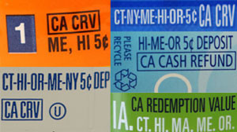
Misc. Changes (SB1013)
Key Points
Dealers delivering returned empty beverage containers to recycling locations are no longer subject to daily load limit QR Codes are now allowed for labeling Wine and spirits exempt from new labeling requirements until July 1, 2025. Manufacturers can self-certify their labels Penalty amounts increased from $1k to $5k; increased from $5k to $10k for intentional violations.

Slide 14
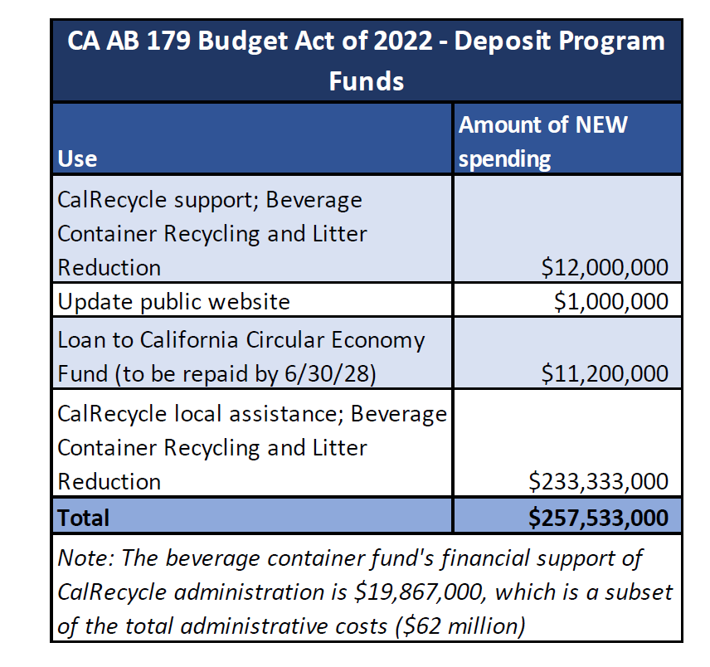

Slide 15
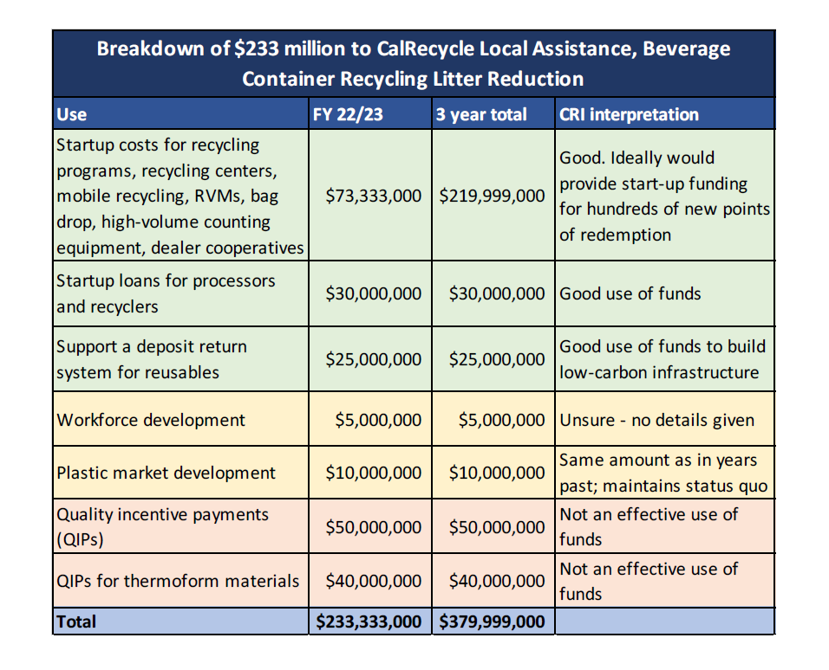

Slide 16
Financial Summary
1) SB 1013: $900 million in spending over 6 years.
2) AB 179: nearly $400 million in spending (IF 3-year spending materializes).
3) The 2 bills total $1.3 billion in spending.
4) Beverage container fund balance was last reported at $635 million.
5) Overspending will have to be addressed.
6) Sequencing may need to be addressed.

Slide 17



Thank You!
Learn
  Main Website www.container-recycling.org
  Bottle Bill Website www.bottlebill.org
Connect
  Facebook www.facebook.com/container.recycling
  Twitter @CRI_recycle
  LinkedIn www.linkedin.com/company/container-recycling-institute
Contact
  Tel (310) 559-7451
  Email scollins@container-recycling.org

Slide 18
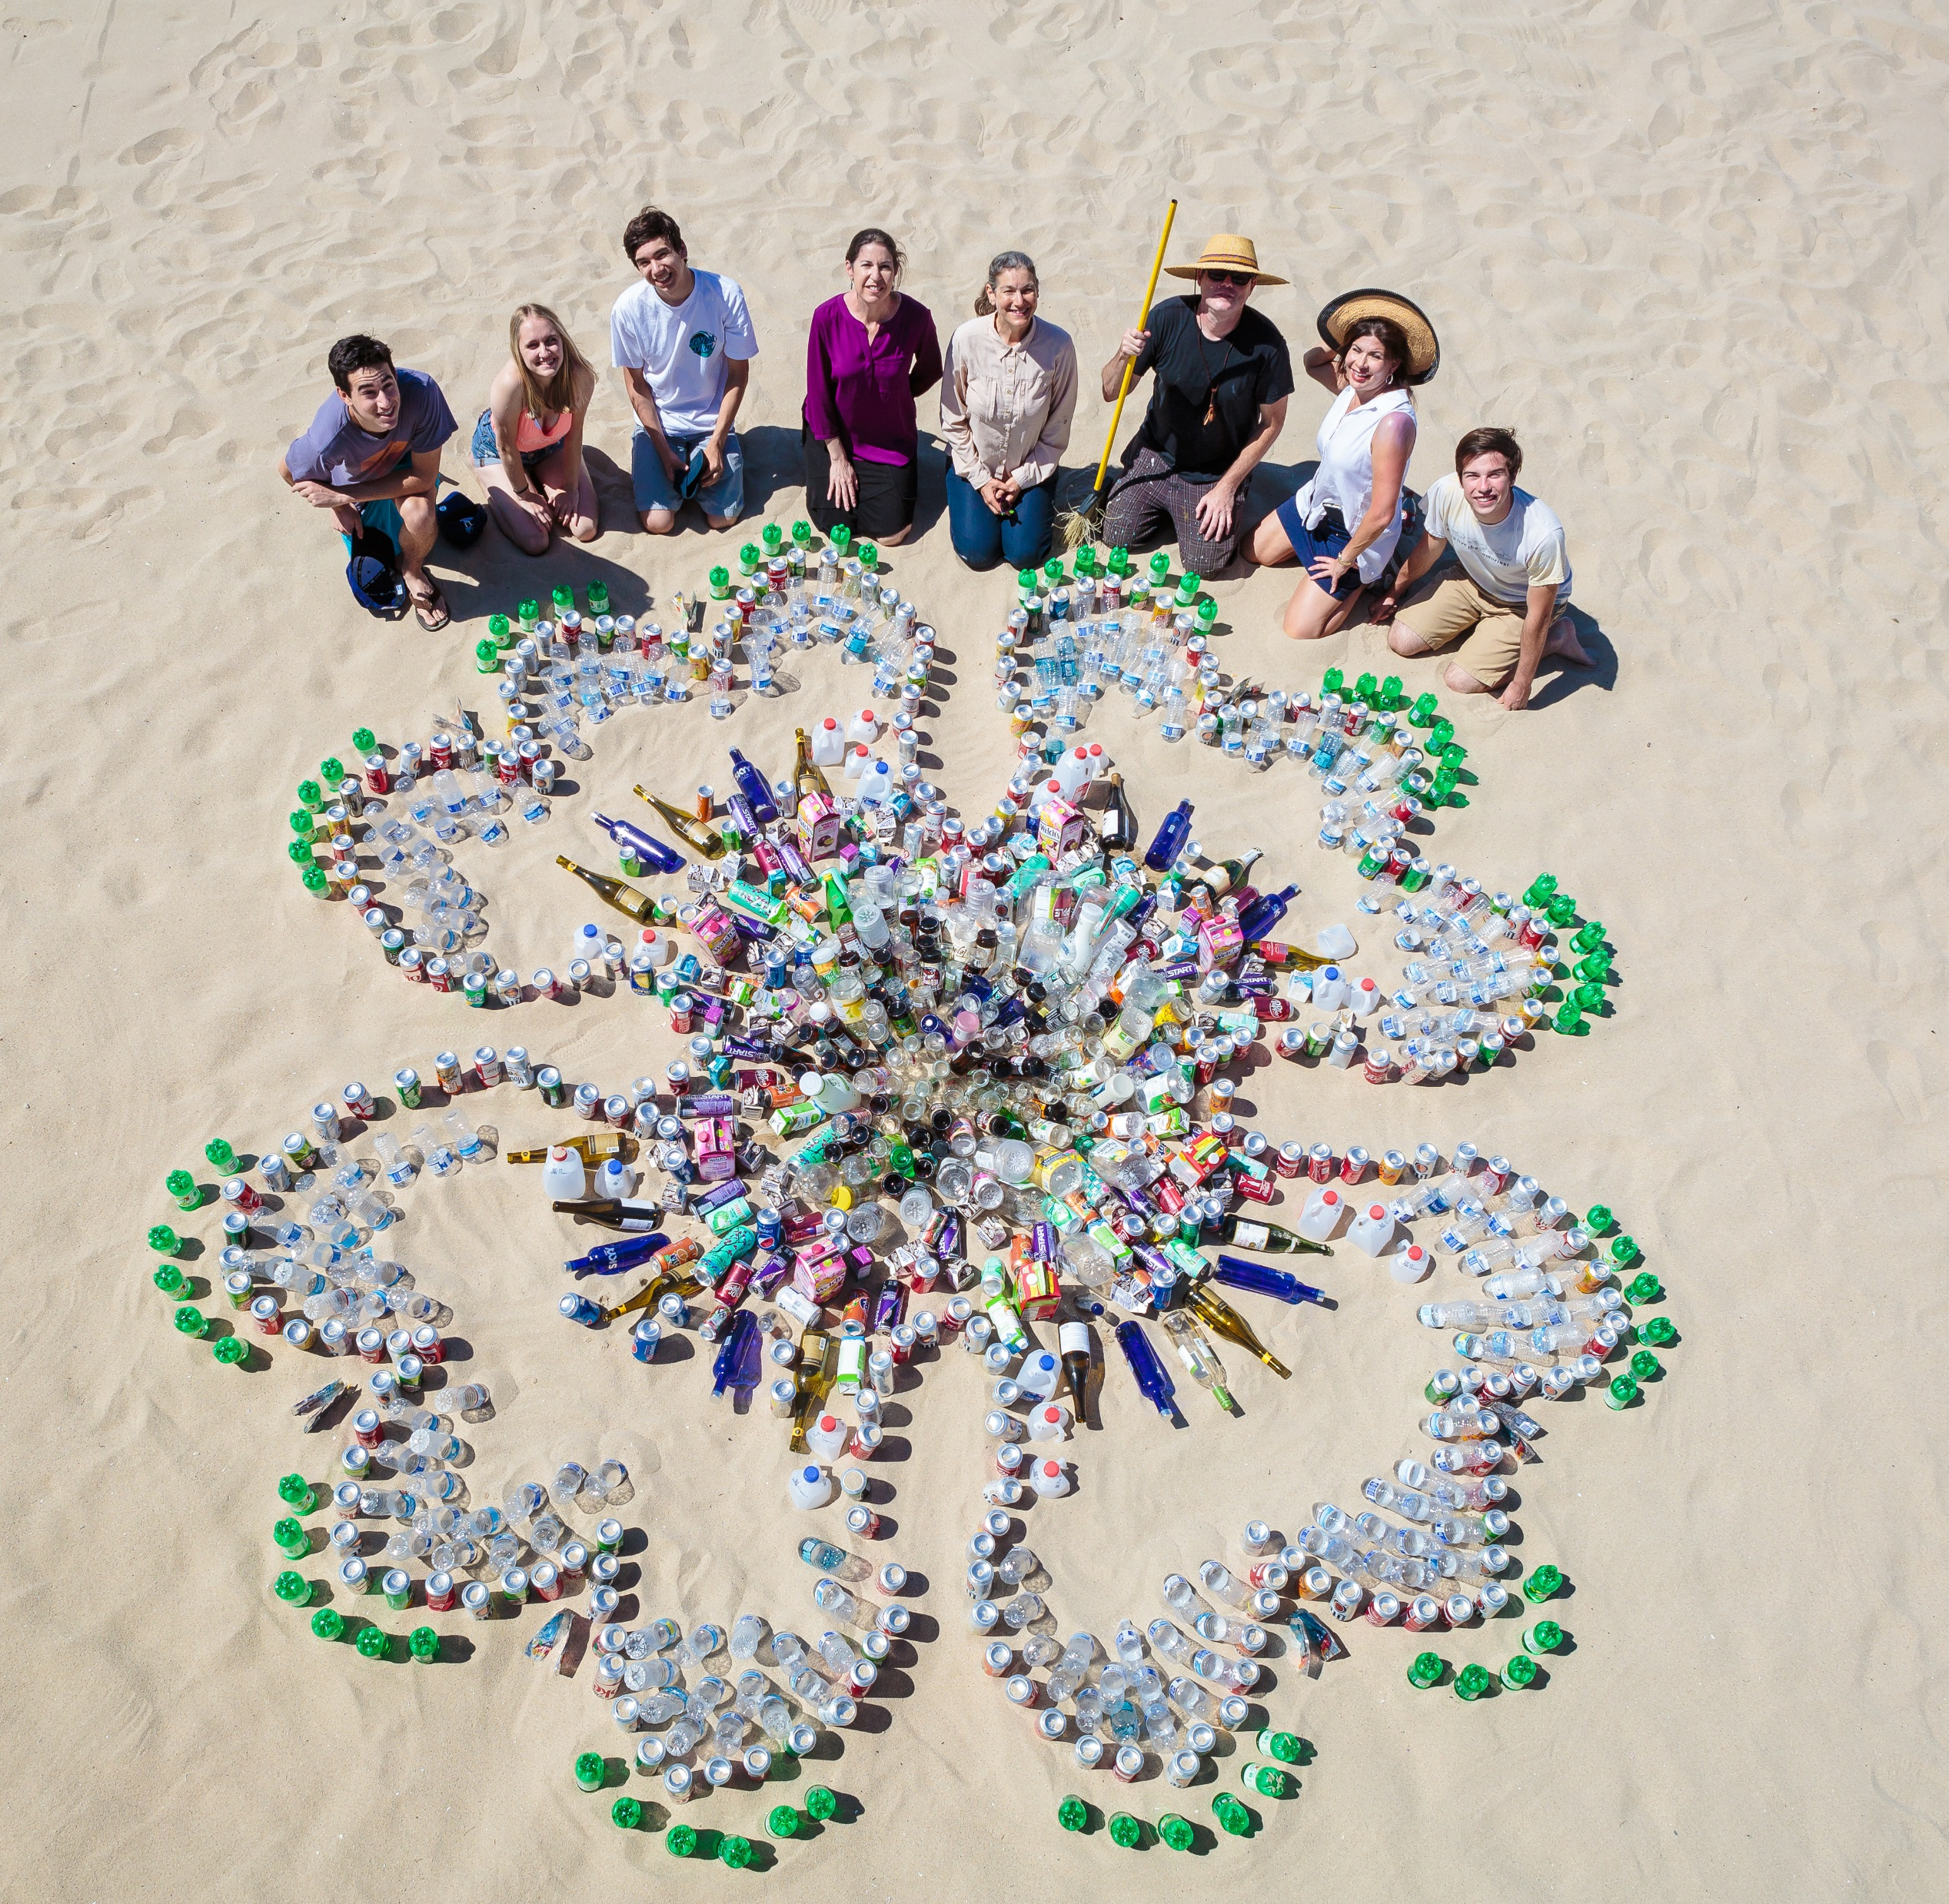
Container Recycling Institute © 2018

