Slide 1
Artificial Turf vs Natural Grass Fields
November 20, 2025
Artificial Turf Ad Hoc Committee
formed Dec 12, 2024 by:
Sonoma County Local Task Force (LTF) on Integrated Waste Management

Slide 2
Introduction
The LTF was formed as a requirement of the AB 939 Integrated Waste Management act of 1989
The LTF was formed as an advisory group to the Board of Supervisors and Zero Waste Sonoma on Integrated Waste Management issues
LTF formed an Ad Hoc committee to study and compare the benefits and impacts of using natural grass versus artificial turf for community sports fields
LTF’s initial primary focus was on the solid waste, recycling and environmental impacts of these alternatives
The group’s research also included a review of Public Health and Safety and Financial issues
The group’s findings and recommendations are included in this presentation

Slide 3
Purpose of Ad Hoc Committee
To conduct a thorough analysis of the solid waste, recycling, environmental and other impacts, associated with the use of artificial turf compared to natural grass, and to provide the group’s findings and recommendations to Zero Waste Sonoma, the Board of Supervisors (BOS) or other Sonoma County jurisdictions to help inform policy decisions regarding the future use of these materials, with a focus on minimizing landfill waste and environmental harm.

Slide 4
Presentation Outline
Purpose of LTF and Ad Hoc Committee on Artificial Turf
Definitions
Project Approach
Findings on Subject Matter Areas in Natural vs Artificial Grass Comparison
Environmental Impacts: Solid Waste, Recycling, and Water/Soil Quality
Public Health & Safety: Disproportionate impacts on vulnerable communities
Financial Impacts : Liability, Installation, Replacement, Disposal, Playing time, Maintenance
Recommendations to Zero Waste Sonoma Board of Directors

Slide 5
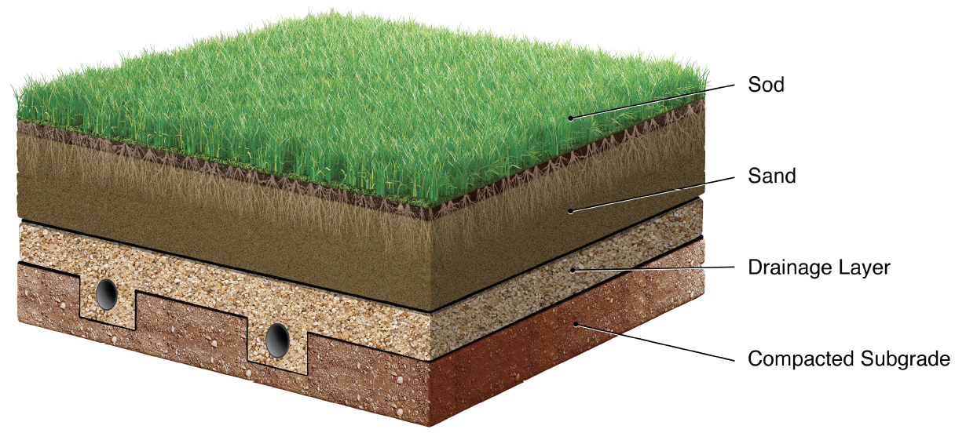
Definitions: Natural Turf / Grass
A living, photosynthesizing organism that is used for lawns, sports fields, and other surfaces

Slide 6
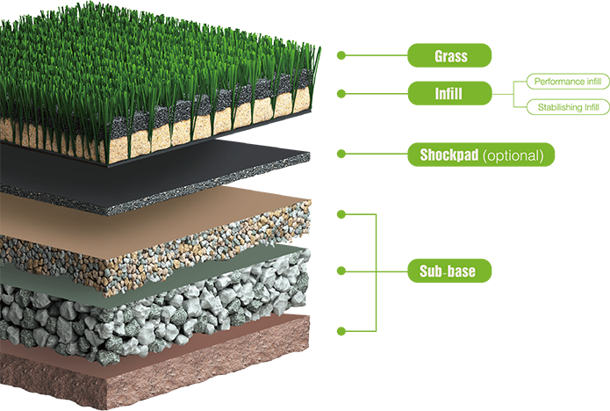
Definitions: Artificial Turf
A surface made of synthetic fibers designed to look like natural grass, used for applications like sports fields, playgrounds, and residential lawns

Slide 7
Artificial Turf in Sonoma County
SRJC
Tom Schopflin Fields Regional Park
Maxwell Farms Regional Park
Lucchesi Park
Petaluma City Sports Complex
East Washington Park Petaluma
Various school districts
Residential and commercial landscaping

Slide 8
Project Approach
Conduct literature review
Consult subject matter experts
Discuss and establish consensus within Committee
Develop recommendations

Slide 9
Findings on Subject Matter Areas in
Natural Grass vs Artificial Turf Comparison
Environmental Impacts: Recyclability, Water/Soil/Air Quality, Climate Impact
Public Health & Safety: Documented health and safety hazards such as Extreme heat illness, Injuries, and Exposures to toxic chemicals create disproportionate impacts on Vulnerable Communities
Financial Impacts: Installation, Disposal, Playing time, Maintenance

Slide 10
Findings: Environmental Impacts
 | Natural Grass | Artificial Turf
Pros | Can be irrigated with recycled water Pesticides & fertilizers often used Cools naturally Sequesters carbon and releases oxygen Protects watershed and preserves soil ecosystem | Generally less water use Pesticides and fertilizers often not required
Cons | Generally more water use Greenhouse gas emissions - mowers | Lack of recycling infrastructure and data Greenhouse gas emissions – materials derive from fossil fuels Off-gassing of toxic chemicals and microplastics exposes humans, wildlife, and water to hazards Heavier load on water treatment processes Requires only potable water use Heat island effect

Slide 11
Findings: Environmental Impacts
University of Missouri Turfgrass Research Center (2010)
Synthetic grass temperature increases of 50 to 70 ° F over natural grass.
On blue-sky days in mid-summer where air temperatures were at 98 degrees Fahrenheit with calm winds, temperatures would exceed 160 ° F on synthetic surfaces.
Natural grass under these same conditions would range between 99 and 102 ° F
Santa Clara County Medical Association (2024)
Synthetic turf in Sunnyvale (111-138 °F) versus the immediately surrounding area (102-111°F)
UC Ag & Natural Resources, California (2024)
Artificial grass found at 173 ° F in Palm Springs
Montclair State University, New Jersey (2025)
Artificial grass was 182% hotter than the natural grass field when measured with infrared thermometer during a mid-day reading in June.

Slide 12
Disposal
Natural Grass disposal options
Proper maintenance reduces need for renovation (every 5-10 years)
Disposal typically not necessary. If needed, materials composted or mulched
Artificial Turf disposal options
Landfill
Stockpile
Limited or no recycling options
Data limitations on artificial turf disposal
Unclear disposal practices and locations
Lack of language in contracts requiring recycling or proper disposal
Lack of contract language verifying final material disposition

Slide 13
Findings: Public Health & Safety Impacts
Vulnerable Communities are disproportionately impacted by the health impacts of contaminants like heavy metals, PFAS, and plastics
  Examples: Children, low-income, elderly, persons with disabilities
 | Natural Grass | Artificial Turf
Pros | Natural sanitation Higher shock absorption Natural cooling on hot days | Provides more playing time – rainy seasons
Cons | Injury risk in the case of improper maintenance Less playing time in rainy seasons | Toxic chemicals in artificial turf: Plastic and rubber materials can melt and off-gas toxic chemicals Exposure to PFAS, nano and microplastics, and other toxic chemicals in turf products linked to cancer, hormone disruption, and immune harm (PAHs, VOCs, heavy metals) Limited playing time on extreme heat days Risk of legal claims from injuries and latent disease Heat related illness: dehydration, heat stroke, skin burns Increased infections (poor sanitation practices) Higher injury rates (cushioning fails with wear)

Slide 14
Findings: Public Health & Safety Impacts
Professional sports
NFL Players Association, FIFA, and others showing preference to natural grass, citing higher injury rates, health concerns related to chemical exposure, and comfort of gameplay
Banned
City of Millbrae
West Sacramento: non-functional
San Marino
Boston, Sharon, Concord, Wayland, Westport (Massachusetts)
State of Colorado (in effect 1/1/2026)
Moratorium
State of New York
Considering ban/moratorium
City of Santa Rosa
City of Sebastopol
City of Los Angeles
City of Santa Monica
City of Sunnyvale

Slide 15
Findings: Financial Impacts
 | Natural Grass | Artificial Turf
Pros | Less expensive upfront installation Stable long-term costs Resilient grasses use less water | Generally less water use Provides more playing time – rainy seasons
Cons | More frequent maintenance needs Liability / Injury risk in the case of improper maintenance Currently provides less playing time year-round (rainy seasons) | Increasing installation, replacement, and disposal costs disposal costs across industry Specialized maintenance needs – disinfectant & repair Conversion back to natural grass requires mitigation of long-term soil damage Liability Many unknown chemicals Injury risk in the case of improper maintenance Extreme heat day limitations on playing time More playing time year-round

Slide 16
Recommendations to Zero Waste Sonoma Board of Directors
  Direct staff to develop a model ordinance to assist municipal staff in implementing a moratorium or ban on artificial turf until further research is conducted to ensure product safety
  Require life-cycle cost analysis of both options before deciding on field material
  Require responsible replacement/disposal in turf installation contracts
  Collect, analyze, and maintain data regarding turf (artificial and natural grass) installation, replacement, and disposal in Sonoma County

Slide 17
Discussion / Questions
Artificial Turf vs Natural Grass Fields
November 20, 2025
Artificial Turf Ad Hoc Committee
formed Dec 12, 2024 Sonoma County Local Task Force (LTF) on Integrated Waste Management

