Slide 1
2022 Waste Characterization Study
Presented to Zero Waste Sonoma

Slide 2
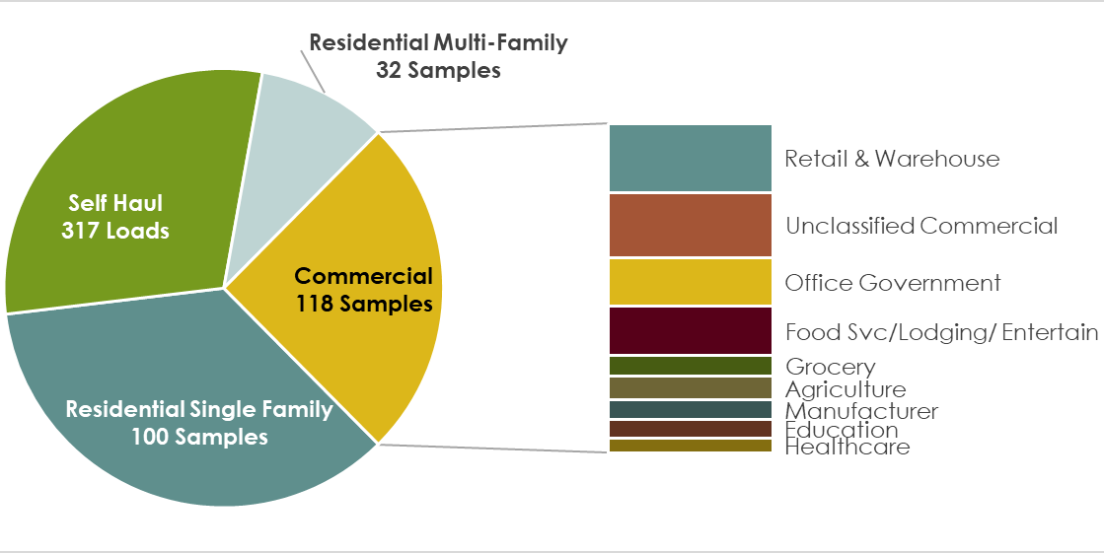
Sampling Plan
Study Included:
250 hand-sorted samples from residential and commercial sources
317 visually characterized samples from self-hauled waste
8 commercial generator types
Assistance from Recology and Republic

Slide 3
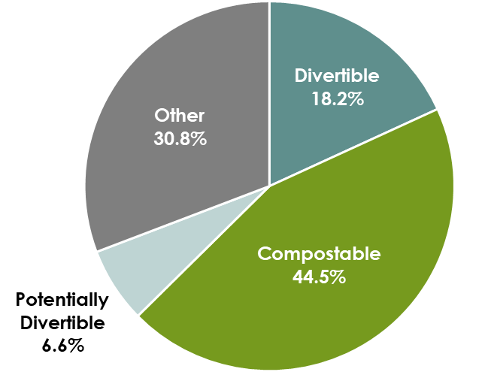
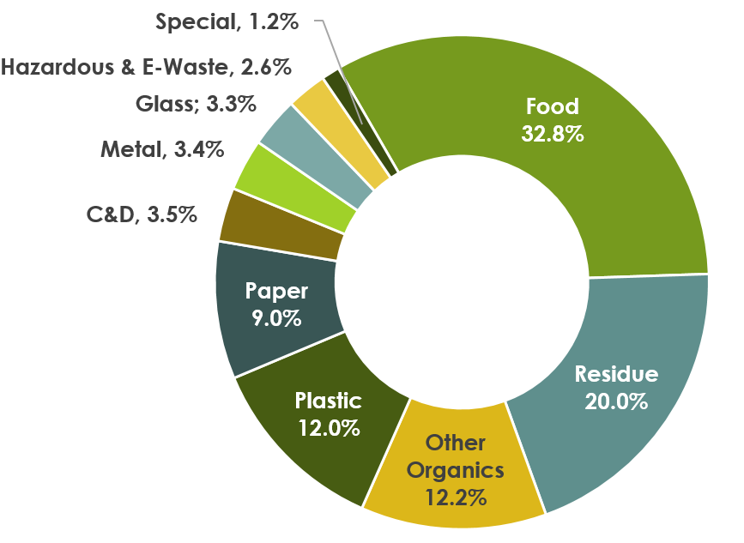
Single Family Residential Waste (2022)
Top Materials:
Food Waste – 32.8%
Residue – 20.0%
Organics – 12.2%
Plastic – 12.0%

Slide 4
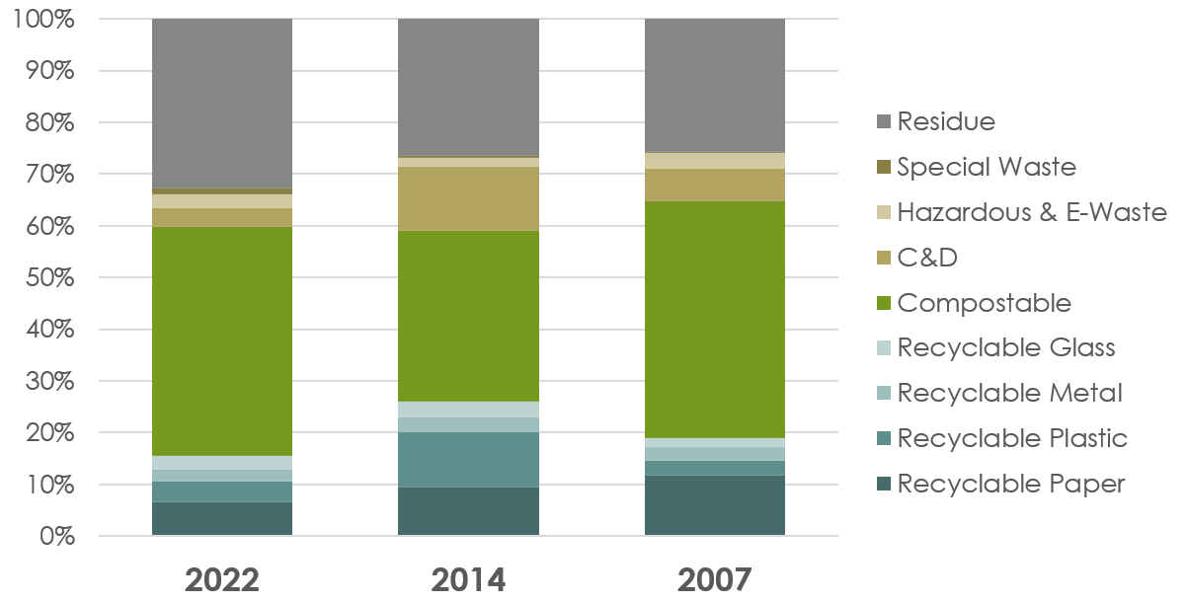
Single Family Residential Waste: Changes between 2007 and 2022
Biggest Changes:
Recyclables – decrease from 26.1% (2014) to 15.4% (2022)
Compostables – up to near 2007 levels of 44.4%
C&D at all time lows
Residue now makes up over 30%

Slide 5
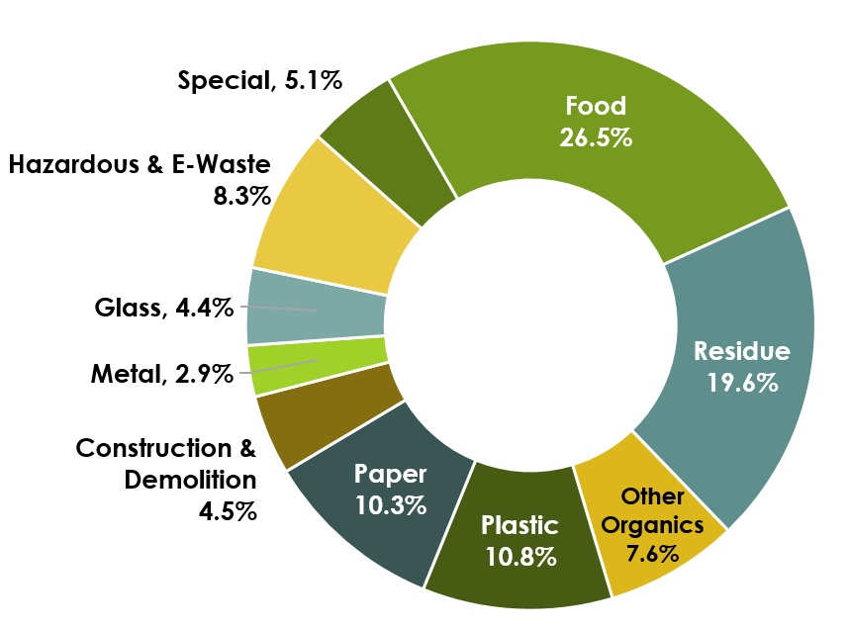
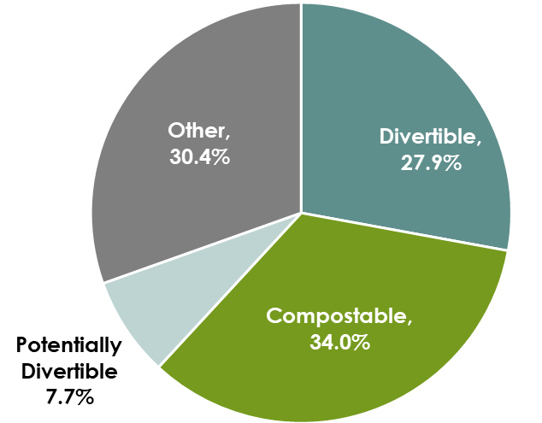
Multi-Family Residential Waste (2022)
Top Materials:
Food Waste – 26.5%
Residue – 19.6%
Plastic – 10.8%
Paper – 10.3%

Slide 6
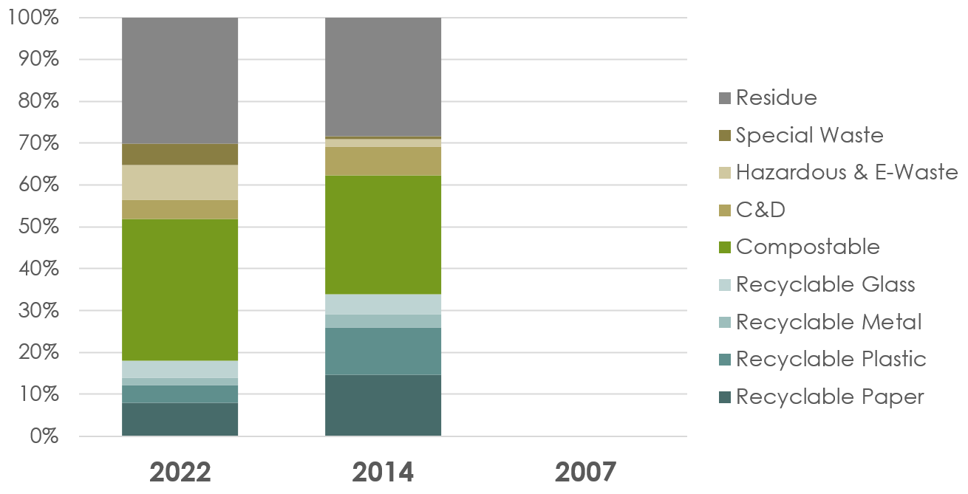
Multi-Family Residential Waste: Changes between 2007 and 2022
Biggest Changes:
Recyclables – decrease from 33.8% (2014) to 17.9% (2022)
Compostables – up 5.5%
C&D composition increase
Residue makes up same composition of stream

Slide 7
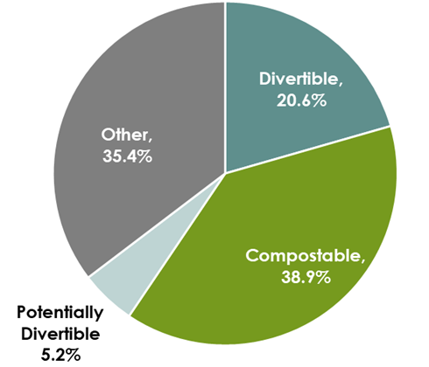
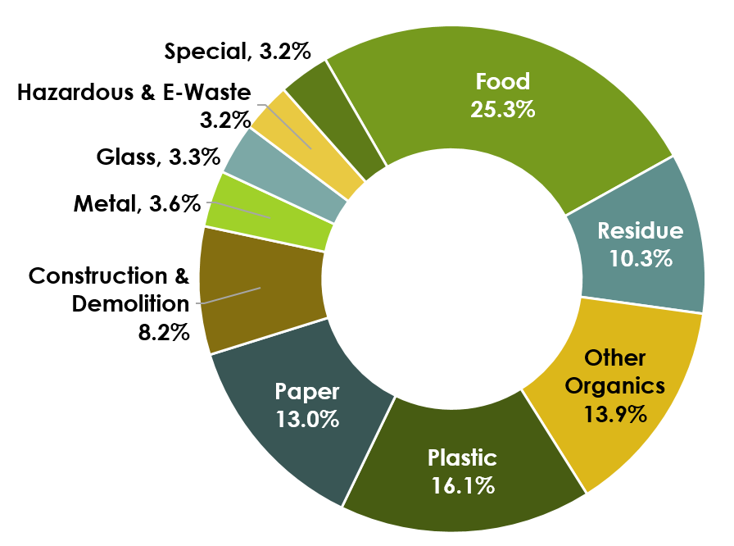
Commercial Waste (2022)
Top Materials:
Food Waste – 25.3%
Plastic – 16.1%
Organics – 13.9%
Paper – 13.0%

Slide 8
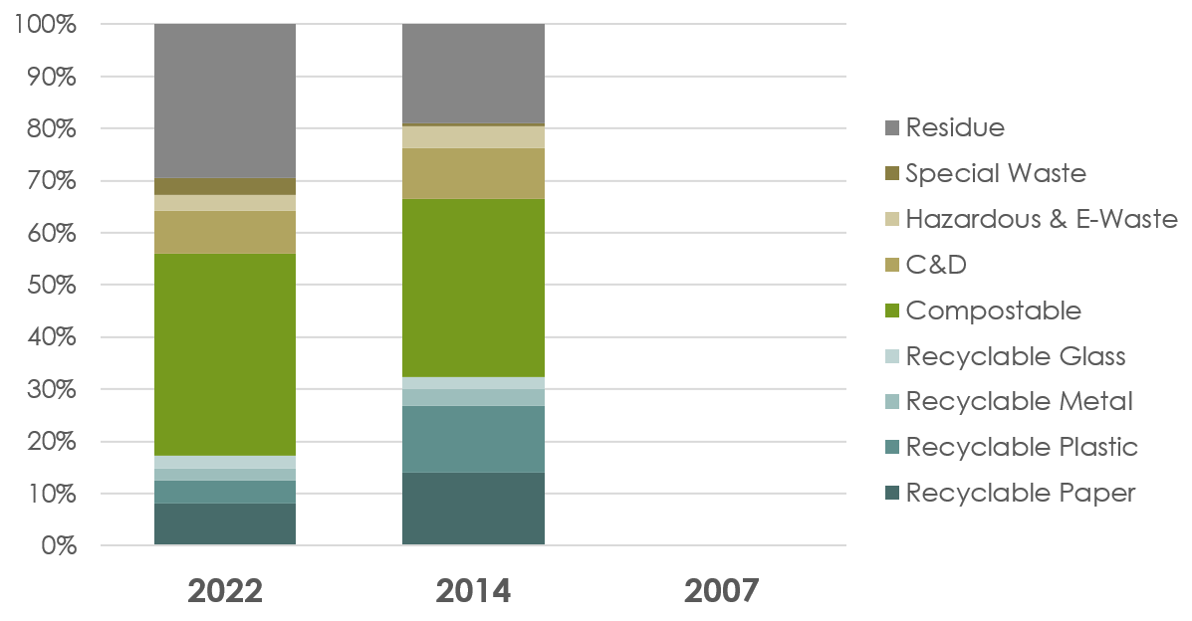
Commercial Waste: Changes between 2014 and 2022
Biggest Changes:
Recyclables – decrease from 32.4% (2014) to 17.1% (2022)
Compostables – overall composition increase by 4.6%, possibly explained by decrease in recyclables

Slide 9
Self-Hauled Waste (2022)
Top Materials:
Mixed Residue – 50.0%
C&D – 28.5%
NOTE: “Mixed Residue” may contain divertible materials
Notes:
We decided to separate non-divertible waste into “mixed residue” and “other waste” because mixed residue makes up such a large portion and may contain divertibles that were not sorted for

Slide 10
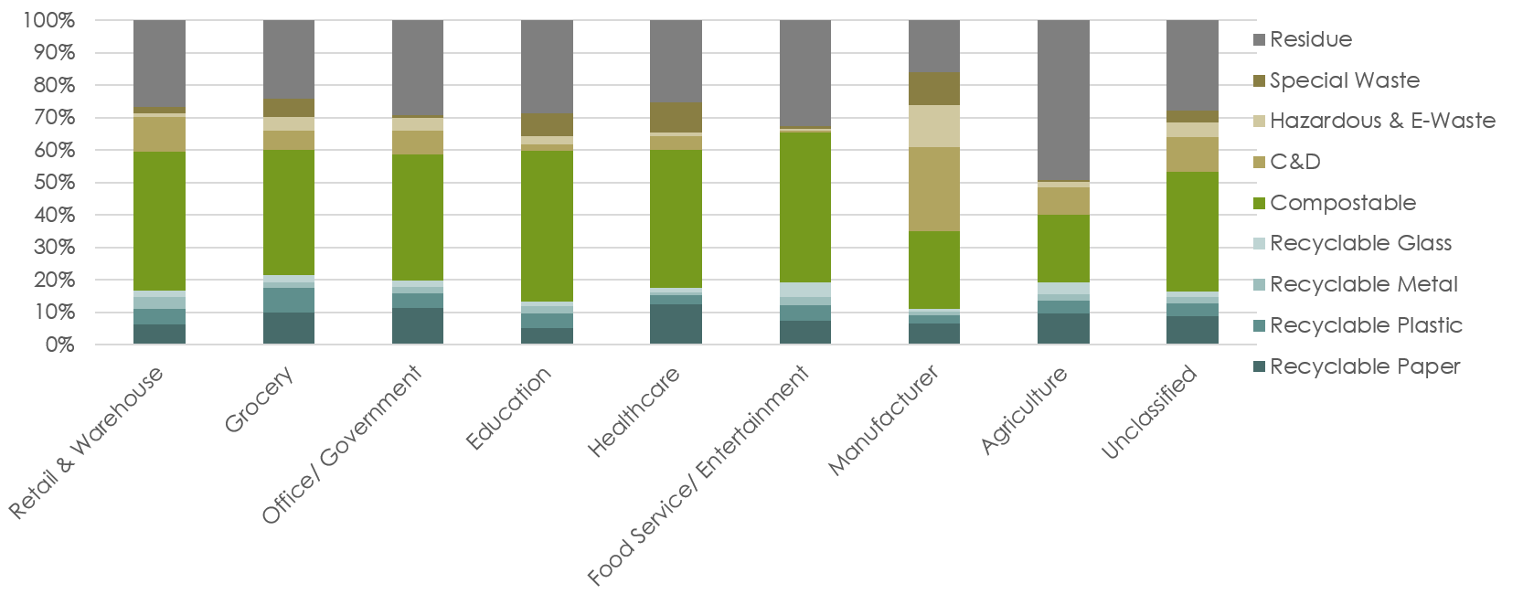
Commercial Waste by Source
Notable Differences:
C&D high for Manufacturers
Office, Grocery, and Healthcare have more recyclable paper
Compostable waste prevalent in Food Service and Education

